Slide 1
UNIT – 2 Part I
Programming in C (COM412)
BSc CSIT First Semester
Mid-West university
Birendranagar, Surkhet, Nepal
Prepared by:
Dabbal Singh Mahara
Asst. Prof.
2022

Slide 2
Unit 2 Data types and variables
Character set, C Tokens, Variables,
Data types (integer, floating, character, type conversion, type definitions, sizeof operator)
Symbolic constants, Escape sequence,
Preprocessor Directives
printf() and scanf() functions

Slide 3
Character set
The set of characters that are used to form words, numbers and expressions in C is called C character set.
The combination of these characters form words, numbers and expressions.
The C character set is grouped into the following four categories:
Letters or alphabets
Digits
Special Characters
White Spaces

Slide 4
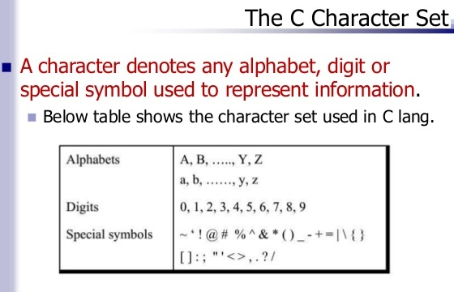

Slide 5
Letters
Uppercase: A……Z
Lowercase: a……z
Digits
All decimal digits: 0……9
Special Characters
, comma
. period
; semicolon
: colon
? question mark
‘ apostrophe
“ quotation mark
! exclamation mark
| vertical bar

Slide 6
/ slash
\ backslash
~ tilde
_ underscore
$ dollar sign
% percent sign
& ampersand
^ caret
* asterisk
- minus sign
+ plus sign
< opening angle bracket (or less than sign)
> closing angle bracket (or greater than sign)
( left parenthesis
) right parenthesis

Slide 7
[ left bracket
] right bracket
{ left brace
} right brace
# number sign
White Spaces
Blank space
Horizontal tab
Carriage return
New line
Form feed

Slide 8
C tokens
In a C program the smallest individual units are known as C tokens.
C tokens are the basic buildings blocks in C language which are constructed together to write a C program.
These are the basic elements recognized by the C compiler.

Slide 9
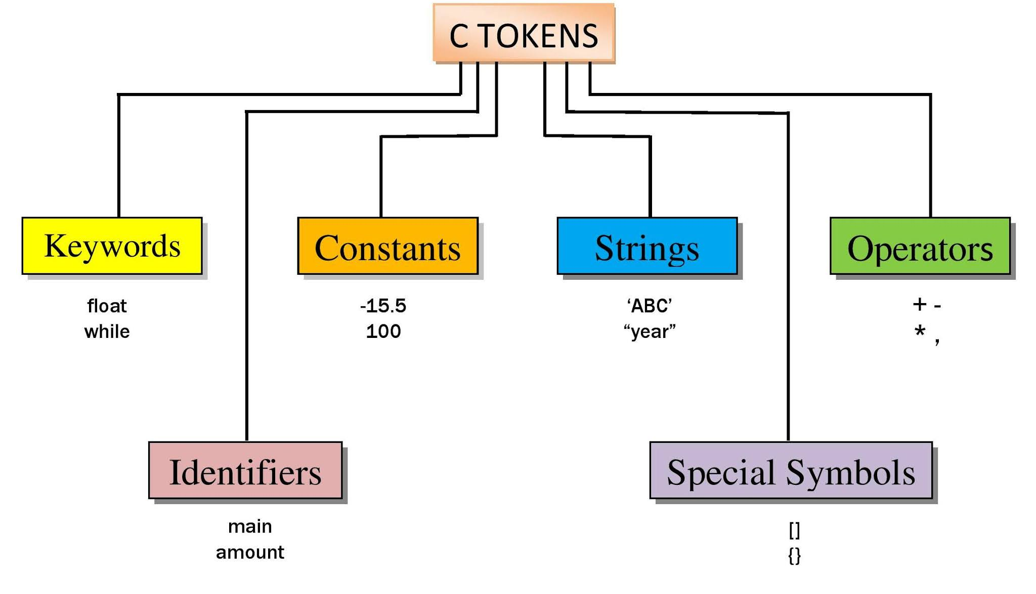

Slide 10
Keywords
Every C word is classified as either a keyword or an identifier.
Keywords are predefined words in C programming language.
All keywords have fixed meaning and these meanings cannot be changed.
Keywords are also called reserved words because they are used for pre-defined purposes and cannot be used as identifiers.
There are total of 32 keywords in C.

Slide 11
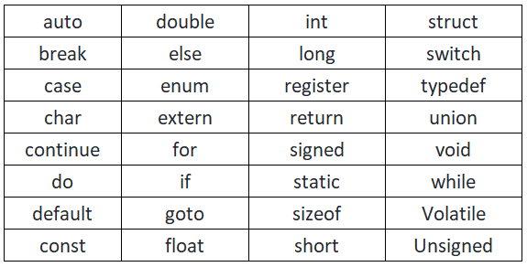
ANSI C keywords

Slide 12
identifiers
Every word used in C program to refer to the names of variables, functions, arrays, pointers and symbolic constants are called identifiers.
These are user-defined names and consist of a sequence of letters and digits, with a letter as the first character.
Both uppercase and lowercase letters can be used, although lowercase letters are commonly preferred.
The underscore character can also be used to link between two words in long identifiers.

Slide 13
Rules for identifiers
First character must be an alphabet (or underscore).
Must consist of only letters, digits or underscore.
Must not contain white space. Only underscore is permitted.
Keywords cannot be used.
Only first 31 characters are significant.
It is case-sensitive, i.e. uppercase and lowercase letters are not interchangeable.

Slide 14
TEST
Determine which of the following are valid identifiers? If invalid, explain why?
(a) keyword (b) n1+n2
(c) file_3 (d) #ph_no
(e) double (f) Rs2000
(g) doubles (h) first_name
(i) 2var (j) first-name
(k) $1000 (g) return
(h) _1 (j) inta
(k) _ (l) __

Slide 15
Examples: identifiers
#include<stdio.h>
int main()
{
int length, breadth;
int area;
return 0;
}

Slide 16
constants
Constants in C refer to fixed values that do not change during the execution of a program.
C constants can be divided into different categories:
Numeric Constants
Integer Constants
Real Constants
Character Constants
Single Character Constants
String Constants

Slide 17
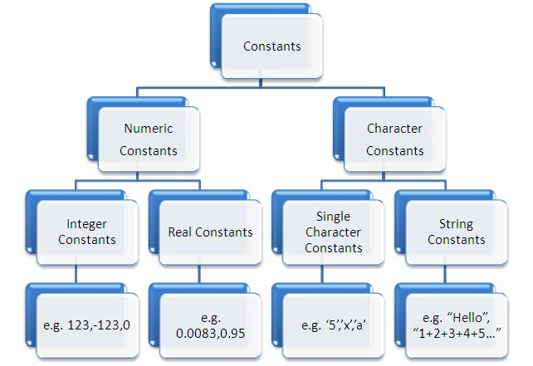

Slide 18
Integer constants
Integer Constant refers to a sequence of digits (at least one digit) with no decimal point and either positive or negative.
If no sign precedes an integer constant, it is assumed to be positive.
No commas or blank spaces are allowed within the integer constant.
E.g. 0, 123, +365, -555, etc.
$1000, 20,000, 22 329, are not allowed.

Slide 19
Integer constants…
Three types:
Decimal Integer Constants
Octal Integer Constants
Hexadecimal Integer Constants
Decimal Integer Constants: Decimal integers consist of a set of digits, 0 through 9, preceded by an optional – or + sign. E.g. +78, 0, 123, etc.
Octal Integer Constants: An octal integer constant consists of any combination of digits from the set 0 through 7, with a leading 0. E.g. 056, 0, 0123, etc

Slide 20
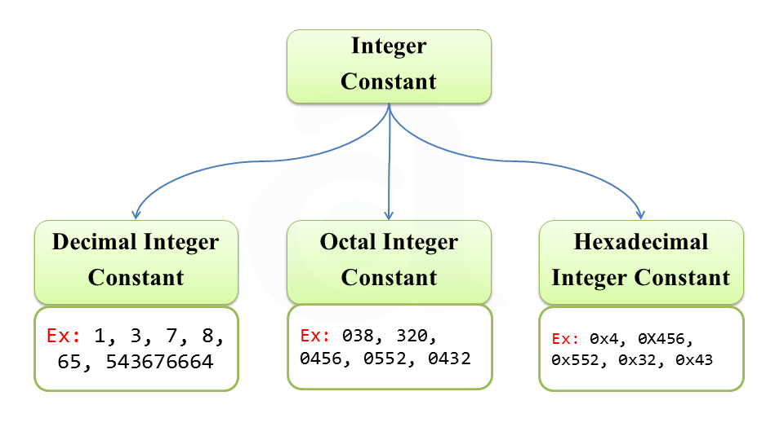

Slide 21
Integer constants…
Hexadecimal Integer Constants:
A hexadecimal integer constant consists of any combination of digits from the set 0 to 9, and alphabets A through F or a through f with a leading 0X or 0x.
The letters A through F represent the numbers 10 through 15.
E.g. 0X2, 0x9F, 0Xabc, 0x0, etc.
NOTE: Octal and Hexadecimal numbers are rarely used in programming.

Slide 22
#include <stdio.h>
#include <conio.h>
int main()
{
int a,b,c;
a=10;
b=010;
c=0xFF;
printf("Decimal integer is %d",a);
printf("\nOctal integer is %d",b);
printf("\nHexadecimal integer is %d",c);
getch();
}

Slide 23
Real constants
Integer numbers are inadequate to represent quantities that vary continuously, such as distances, heights, temperatures, prices and so on.
These quantities are represented by numbers having fractional parts like 3.14.
Such numbers are called real (or floating point) constants.
E.g. 0.00123, -0.25, +125.0, 23.35, etc
Real constants can be written into two forms: fractional form and exponential form.

Slide 24
Fractional form constants
Fractional form constants must have at least one digit and a decimal point.
It can either be positive or negative but the default sign is positive.
Commas or blank spaces are not allowed within a real constant.
E.g. +23.45, 456.0, -23.35, -5544.312, etc are in fractional form.

Slide 25
Exponential form constants
In exponential form of representation, the real constant is represented in two parts as, mantissa e exponent
The digits before ‘e’ is called mantissa and after is called exponent.
The mantissa part may have a positive or negative sign, but the default is positive.
The exponent must have at least one digit (must be integer), which can be either positive or negative.
E.g. -3.2e-4 implies [-3.2*10⁻⁴]
-0.2e+3 implies [-0.2*10³]

Slide 26
#include <stdio.h>
#include <conio.h>
int main()
{
float x;
x=-3.2e-4;
printf("\nFloating point constant is %f",x);
getch();
}

Slide 27
Single Character constants
A single character constant (or simply character constant) contains a single character alphabet, a digit or a special symbol enclosed within a pair of single quote marks.
E.g. ‘5’, ‘X’, ‘;’ ‘ ’, etc.
Character constants have integer values known as ASCII values.
NOTE: The character constant ‘5’ is not the same as the number 5.
NOTE: ‘A’ is a valid character constant but ‘AA’ is not.

Slide 28
#include <stdio.h>
#include <conio.h>
Int main()
{
int n = 4;
char c = ‘4’;
n = n + 5; //n=4+5=9
c = c + 5; //c=52+5=57
printf(“Integer = %d”,n);
printf(“\nCharacter = %d”,c);
getch();
}

Slide 29
#include <stdio.h>
#include <conio.h>
int main()
{
char x;
x='A';
printf("The character %c's ASCII value is:%d", x, x);
getch();
}
Note: To find the ASCII value of \, we have to write a=‘\\’;. Writing a=‘\’; gives error. Similarly to find out ASCII values of enter and backspace keys we have to write ‘\n’ and ‘\b’.

Slide 30
String constants
A string constant is a sequence of characters enclosed in double quotes.
The characters may be letters, numbers, special characters and blank space. However, it does not have an equivalent ASCII value.
E.g. “Hi!”, “2011”, “WELL DONE”, “?...!”, “5+3”, “X”, etc.
NOTE: A character constant (e.g. ‘X’) is not equivalent to the single character string constant (e.g. “X”). Also, “5+3” is a string rather than an arithmetic operation

Slide 31
variables
A variable is a data name that is used to store a data value.
Its value can be changed, and it can be reused many times.
A variable represents name of the memory location.
It is a way to represent memory location through symbol so that it can be easily identified.
Since a variable is an identifier, the rules for naming variables are similar to those of identifiers.
A variable name can be chosen by the programmer in a meaningful way so as to reflect its function or nature in the program.
E.g. Average, sum, counter, first_name, etc.
123, (area), %, 25th, Price$, blood group, etc. are not allowed.

Slide 32
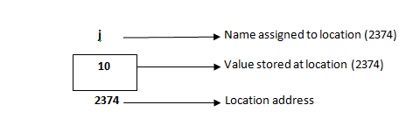
Variable: Example
int j = 10;

Slide 33
Variable declaration
Any variable should be defined before using it in a program.
The variables are defined or declared using following syntax:
data_type variable_name;
where variable_name is the name of the variable.
E.g.
int a;
float radius;
char gender;
int x1,x2,x3;

Slide 34
Data types
A data type specifies the type of data that a variable can store such as integer, floating, character, etc.
C language is rich in its data types. There are other varieties of data types available in C, each of which may be represented differently within computer’s memory.
ANSI C supports 3 classes of data types:
Primary (or fundamental) data types
Derived data types
User-defined data types

Slide 35
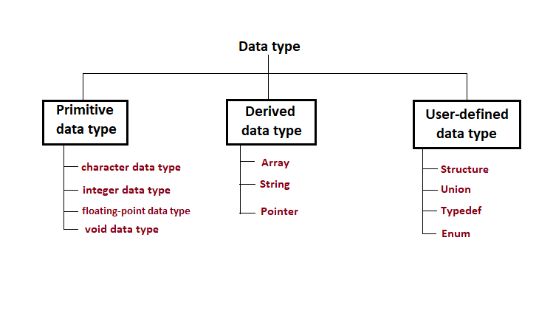

Slide 36
Integer types
Integers are whole numbers (positive, negative and 0), i.e. non-fractional numbers.
If integer data is small then we can use keyword short or short int and to store long integer number we can use long or long int keyword and to store very long number we can use long long or long long int keyword.

Slide 37
Floating point types
Floating point types represent fractional numbers (i.e. real numbers).
The data type qualifier is float.
E.g. Variables are defined as- float a;
Floating numbers reserve 32 bits (i.e. 4 bytes) of storage, with 6 digits of precision.
When the accuracy provided by a float number is not sufficient, the type double can be used to define the number.
A double data type number uses 64 bits (8 bytes) giving a precision of 14 digits. These are known as double precision numbers.
To extend the precision further, long double can be used which uses 80 bits (10 bytes) giving 18 digits of precision.

Slide 38
Character type
A single character can be defined as a character type data.
Characters are stored in 8 bits (1 byte).
The data type qualifier is char.
The qualifier signed or unsigned may be used with char.
The unsigned char has values between 0 and 255 while signed char has values from -128 to 127.
The conversion character is c.

Slide 39
In character data type, each character is represented by an ASCII (American Standard Code for Information Interchange) value internally.
For e.g. the character ‘A’ is represented by 65, ‘B’ by 66 and so on for ‘Z’ by 90 and similarly for others.
When a character is displayed using the conversion character d, it will display the ASCII value; and when it is displayed using the conversion character c, it will display the character.

Slide 40
# include <stdio.h>
# include <conio.h>
int main()
{
char c, d;
c=‘A’;
d=‘B’;
printf(“The character is %c”, c);
printf(“\nThe ASCII value of character is %d”, c);
printf(“\n\nThe ASCII value of %c is %d”, d,d);
getch();
}

Slide 41
Void type
The void type has no values.
It is usually used to specify a type of function when it does not return any value to the calling function.

Slide 42
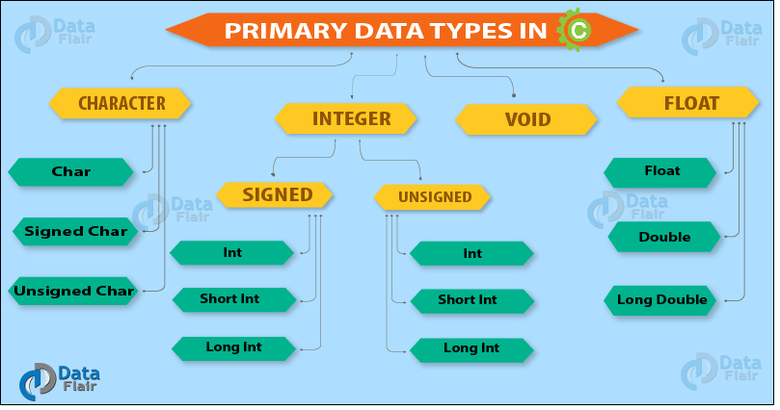

Slide 43
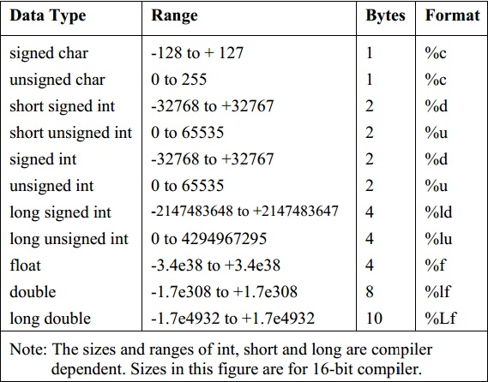

Slide 44
Exercise Problems
Write a C program to add two integers and display the result.
Write a program to calculate simple interest using the formula SI=(P*t*r)/100.

Slide 45
Escape sequences
An escape sequence is a non-printing character used in C.
It is a character combination consisting of a backslash (\) followed by a letter or a digit.
Escape sequences always represent single characters, even though they are written in terms of two or more characters.
Escape sequences has a single ASCII value.
Escape sequences are useful for formatting input and output.

Slide 46
Escape Sequence | Use
\a | Audible Alert or beep sound
\b | Backspace delete on character to the left
\n | Move cursor to the Next or New line of the screen
\v | Vertical tab
\t | Horizontal tab
\’ | Single quote
\” | Double quote
\\ | Backslash
\0 | Null character

Slide 47
#include<stdio.h>
#include<conio.h>
int main()
{
printf(“\aHello \t World \n");
printf("He said \"Hello\" ");
getch();
}

Slide 48
printf() and scanf() functions
printf() and scanf() functions are inbuilt library functions in C programming language which are available in C library by default.
These functions are declared and related macros are defined in “stdio.h” which is a header file in C language.
We have to include “stdio.h” file in program to make use of these printf() and scanf() library functions in C language.

Slide 49
printf()
In C programming language, printf() function is used to print the (“character, string, float, integer, octal and hexadecimal values”) onto the output screen.
We use printf() function with %d format specifier to display the value of an integer variable.
To generate a newline,we use “\n” in C printf() statement.
The general form of printf() is,
printf(“control string”, arg1, arg2, …, argN);

Slide 50
scanf()
In C programming language, scanf() function is used to read character, string, numeric data from keyboard
The general form of scanf() is,
scanf(“control string”, arg1, arg2, …, argN);
#include<stdio.h>
int main(){
int radius; printf(“Enter the radius of circle”);
scanf(“%d”,&radius);
……………………………….
}

Slide 51
Exercise Problems
Write a program that takes radius of circle as input and displays the area and circumference of circle as output.
Write a program that reads height and base of a triangle and finds its area???

Slide 52
Preprocessor directives
These are placed in the source program before the main function.
When our source code is compiled, it is examined by the preprocessor for any preprocessor directives. If there are any, appropriate actions are taken and then the source program is handed over to the compiler.
They follow special syntax rules: They all begin with the symbol # (hash) and do not require a ; (semicolon) at the end.

Slide 53
Preprocessor directives…
E.g. #include <stdio.h>
#define PI 3.14
#define TRUE 1
#define FALSE 0
These statements are called preprocessor directives as they are processed before compilation of any source code in the program.
NOTE: The other codes in the program are compiled sequentially line by line.

Slide 54
Symbolic constants
A symbolic constant is a name that is used in place of a sequence of characters. The character may represent numeric constant, a character constant or a string constant.
When a program is compiled, each occurrence of a symbolic constant is replaced by its corresponding character sequence.
The symbolic constants are defined at the beginning of the program.
SYNTAX: #define name value
E.g. #define PI 3.1416

Slide 55
Symbolic constants…
RULES
Symbolic constant names are same as variable names. Convention: Use capital letters while defining symbolic constants.
No blank space permitted between # and name.
A blank space is required between #define and symbolic name and between symbolic name and its value (i.e. constant).

Slide 56
comments
Used for program documentation.
Comments are not compiled.
The C syntax for writing comment is
/*
Anything written in between slash and asterisk and asterisk and slash is comment
*/
Another way to write comment in C
// Using double slash (This line only)

Slide 57
Type conversion
The process of converting entity of one data type to another data type is called as type casting or type conversion.
There are two types of type conversion:
Implicit type conversion: In implicit type conversion compiler automatically converts one data type into another and it i.e. generally obtained through arithmetic expression.
Explicit type conversion: When a user explicitly convert the one data type into another then it is called as the type casting or explicit type conversion in which programmer specifies special programming instruction what data type to convert.

Slide 58
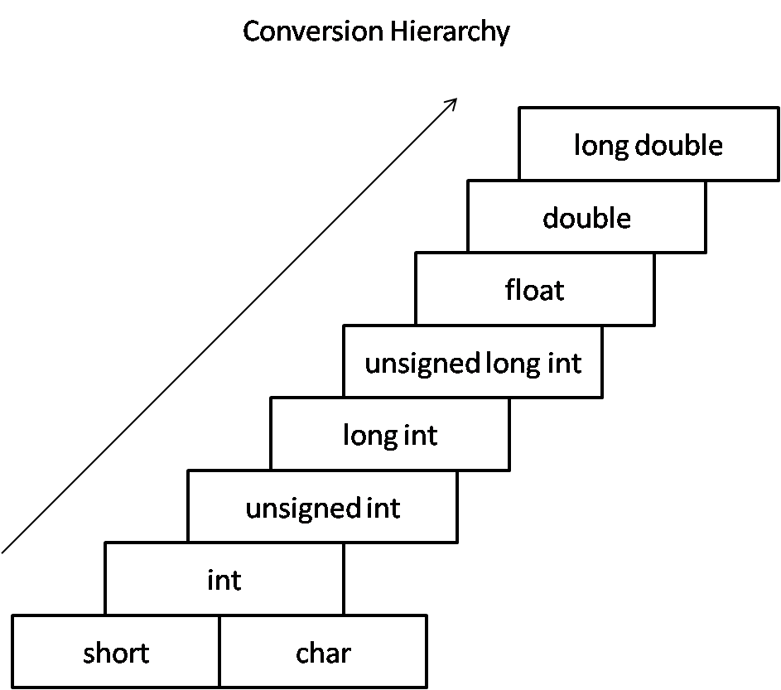
Implicit Type Conversion in C
Lower data types are converted to the higher data types and result is of higher type.

Slide 59
// An example of implicit conversion
#include<stdio.h>
int main()
{
int x = 10; // integer x
char y = 'a'; // character c
x = x + y; // y implicitly converted to int. ASCII value of 'a' is 97
float z = x + 1.0; // x is implicitly converted to float
printf("x = %d, z = %f", x, z);
return 0;
}

Slide 60
Explicit Type Casting
The general form of a type casting operator is
(type-name) expression
It is generally a good practice to use explicit casts than to rely on automatic type conversions.
Example
C = (float)9 / 5 * ( f – 32 )
float to int conversion causes truncation of fractional part
double to float conversion causes rounding of digits
long int to int causes dropping of the higher order bits.

Slide 61
Explicit Type conversion
#include<stdio.h>
int main()
{
float a = 1.2;
int b = (int) a + 1;
printf("Value of a is %f\n", a);
printf("Value of b is %d\n",b);
return 0;
}

Slide 62
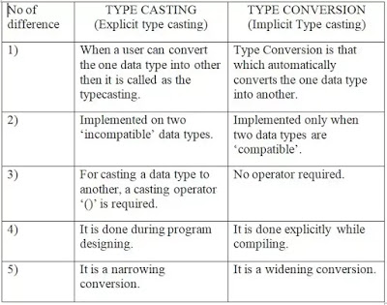
Implicit vs Explicit Type Casting

Slide 63
sizeof operator
The sizeof operator is used with an operand to return the number of bytes the operand occupies.
It is a compile time operator.
The operand may be a constant, variable or a data type qualifier.

Slide 64
Sizeof : example
#include <stdio.h>
#include <conio.h>
int main()
{
int num;
printf("integer Occupies=> %d bytes\n", sizeof(num));
printf("double Constant Occupies=> %d bytes\n", sizeof(16.18));
printf("long int Data Type Qualifier Occupies=> %d bytes\n", sizeof(15L));
printf("float Data Type Occupies=> %d bytes", sizeof(float));
getch();
Return 0;
}

Slide 65
Derived data types
Those data types which are derived from the fundamental data types are called derived data types.
Function, arrays, and pointers are derived data types in C programming language.
For example, an array is derived data type because it contains the similar types of fundamental data types and acts as a new data type for C.
Eg: int a[10];

Slide 66
User definded data types
Those data types which are defined by the user as per his/her will are called user-defined data types.
Examples of such data types are structure, union and enumeration.
For example, let’s define a structure
struct student
{
char name[100];
int roll;
float marks;
};

Slide 67
Enumeration (or enum) in C
Enumeration (or enum) is a user defined data type in C.
It is mainly used to assign names to integral constants, the names make a program easy to read and maintain.

Slide 68
Enum Example
// An example program to demonstrate working
// of enum in C
#include<stdio.h>
enum week {Mon, Tue, Wed, Thur, Fri, Sat, Sun};
int main()
{
enum week day;
day = Wed;
printf("%d",day);
return 0;
}

Slide 69
Enum Example: 2
// Another example program to demonstrate working of enum in C
#include<stdio.h>
enum year {Jan, Feb, Mar, Apr, May, Jun, Jul, Aug, Sep, Oct, Nov, Dec};
int main()
{
int i;
for (i=Jan; i<=Dec; i++)
printf("%d ", i);
return 0;
}

Slide 70
Interesting facts about initialization of enum.
If we do not explicitly assign values to enum names, the compiler by default assigns values starting from 0. For example, in the following C program, sunday gets value 0, monday gets 1, and so on.
#include <stdio.h>
enum day {sunday, monday, tuesday, wednesday, thursday, friday, saturday};
int main()
{
enum day d = thursday;
printf("The day number stored in d is %d", d);
return 0;
}

Slide 71
Enum Example
We can assign values to some name in any order. All unassigned names get value as value of previous name plus one.
#include <stdio.h> enum day {sunday = 1, monday, tuesday = 5, wednesday, thursday = 10, friday, saturday}; int main() { printf("%d %d %d %d %d %d %d", sunday, monday, tuesday, wednesday, thursday, friday, saturday); return 0; }
Output:
1 2 5 6 10 11 12

Slide 72
What will be the output?
#include <stdio.h>
enum week {Sunday, Monday, Tuesday, Wednesday, Thursday, Friday, Saturday};
int main()
{
// creating today variable of enum week type
enum week today;
today = Wednesday;
printf("Day %d",today+1);
return 0;
}

Slide 73
Type Definitions
Type definition allows to create an alias or new name for an existing type or user defined type.
The syntax of typedef is as follows:
Syntax: typedef data_type new_name;
typedef: It is a keyword.
data_type: It is the name of any existing type or user defined type created using structure/union.
new_name: alias or new name you want to give to any existing type or user defined type.

Slide 74
Typedef example
typedef int myint;
From now on we can declare new int variables using myint instead of int keyword.
myint i = 0; // this statement is equivalent to int i = 0;
This statement declares and initializes a variable i of type int.

Slide 75
Homework
What are C tokens?
Define keyword. Write any four keywords in C.
What are rules to define identifiers?
What is a variable?
What are symbolic constants? Write its advantages.
What is data type? Write any four built in data types.
What are the different types of integer data types?
What are the different types of floating point data types?

Slide 76
Homework
Differentiate between literal and symbolic constant.
What is the purpose of typedef?
What is the use sizeof operator?
Define enumerated data type.

Slide 77


